Slide 1
Max 2D Range Sum Problem

Slide 2

Max 2D Range Sum Problem
Given a matrix A of real numbers, a maximum submatrix of A is a nonempty, contiguous submatrix of A whose values have the largest sum. For example, in the following matrix A, A[2 . . 4][2 . . 4], with the sum 29, is a maximum subarray of A.
$$\text{globalMax}=\max_{\text{1}\text{≤}\text{t}\text{≤}\text{m}}{\max_{\text{1}\text{≤}\text{l}\text{≤}\text{n}}{\max_{\text{t}\text{≤}\text{b}\text{≤}\text{m}}{\max_{\text{l}\text{≤}\text{r}\text{≤}\text{n}}{\sum_{\text{i}\text{=}\text{t}}^{\text{b}}{\sum_{\text{j}\text{=}\text{l}}^{\text{r}}{\text{A}\left[\text{i}\right]\text{[ }\text{j}\text{]}}}}}}}$$
 |  |  | l |  | r
 |  | 1 | 2 | 3 | 4 | 5
 | 1 | 1 | 2 | −1 | −4 | −20
t | 2 | −8 | −3 | 4 | 2 | 1
 | 3 | 3 | 8 | 10 | 1 | 3
b | 4 | −4 | −1 | 1 | 7 | −6

Slide 3
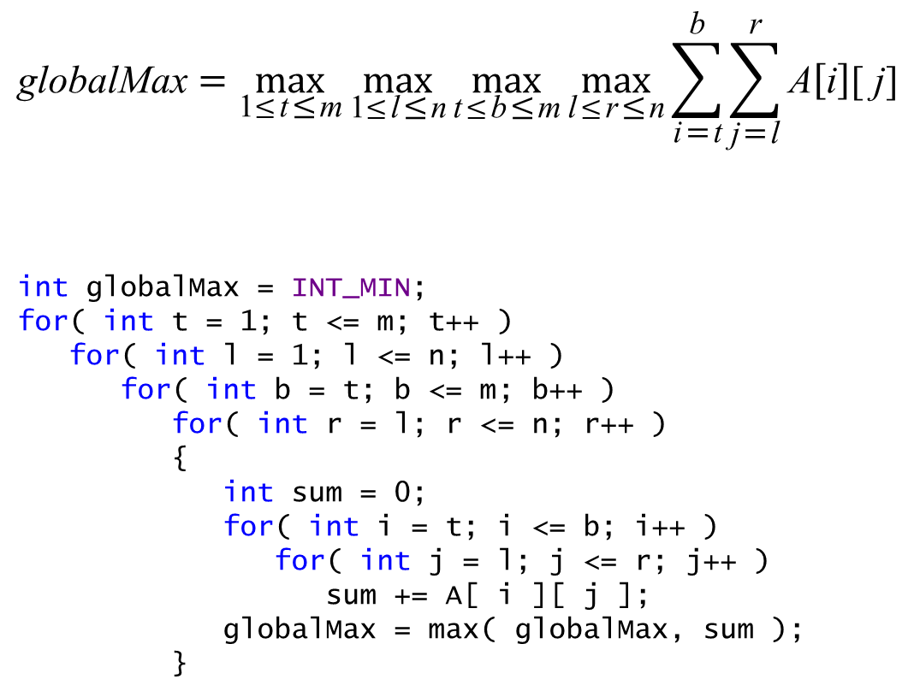
A Complete Search algorithm
$$\text{globalMax}=\max_{\text{1}\text{≤}\text{t}\text{≤}\text{m}}{\max_{\text{1}\text{≤}\text{l}\text{≤}\text{n}}{\max_{\text{t}\text{≤}\text{b}\text{≤}\text{m}}{\max_{\text{l}\text{≤}\text{r}\text{≤}\text{n}}{\sum_{\text{i}\text{=}\text{t}}^{\text{b}}{\sum_{\text{j}\text{=}\text{l}}^{\text{r}}{\text{A}\left[\text{i}\right]\text{[ }\text{j}\text{]}}}}}}}$$
int globalMax = INT_MIN;
for( int t = 1; t <= m; t++ )
for( int l = 1; l <= n; l++ )
for( int b = t; b <= m; b++ )
for( int r = l; r <= n; r++ )
{
int sum = 0;
for( int i = t; i <= b; i++ )
for( int j = l; j <= r; j++ )
sum += A[ i ][ j ];
globalMax = max( globalMax, sum );
}
 |  |  | l |  | r
 |  | 1 | 2 | 3 | 4 | 5
 | 1 | 1 | 2 | −1 | −4 | −20
t | 2 | −8 | −3 | 4 | 2 | 1
 | 3 | 3 | 8 | 10 | 1 | 3
b | 4 | −4 | −1 | 1 | 7 | −6

Slide 4
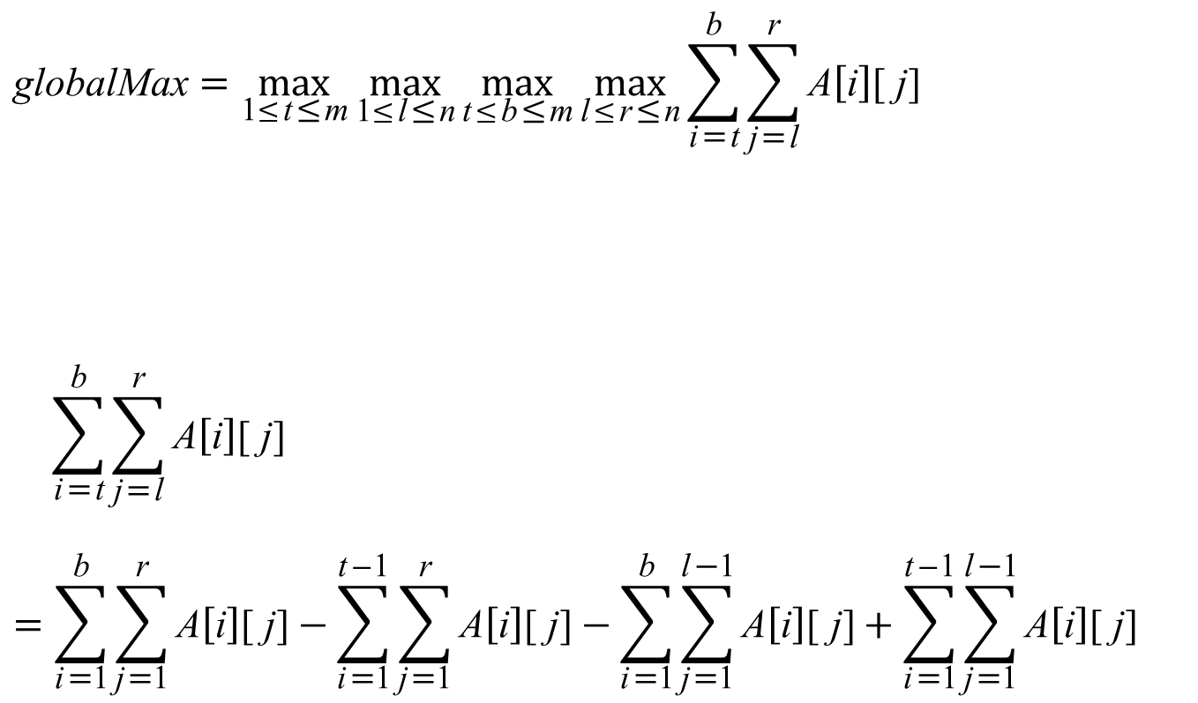
A Complete Search algorithm
$$\text{globalMax}=\max_{\text{1}\text{≤}\text{t}\text{≤}\text{m}}{\max_{\text{1}\text{≤}\text{l}\text{≤}\text{n}}{\max_{\text{t}\text{≤}\text{b}\text{≤}\text{m}}{\max_{\text{l}\text{≤}\text{r}\text{≤}\text{n}}{\sum_{\text{i}\text{=}\text{t}}^{\text{b}}{\sum_{\text{j}\text{=}\text{l}}^{\text{r}}{\text{A}\left[\text{i}\right]\text{[ }\text{j}\text{]}}}}}}}$$
$$\sum_{\text{i}\text{=}\text{t}}^{\text{b}}{\sum_{\text{j}\text{=}\text{l}}^{\text{r}}{\text{A}\left[\text{i}\right]\text{[ }\text{j}\text{]}}}$$
$$=\sum_{\text{i}\text{=}\text{1}}^{\text{b}}{\sum_{\text{j}\text{=}\text{1}}^{\text{r}}{\text{A}\left[\text{i}\right]\text{[ }\text{j}\text{]}}}−\sum_{\text{i}\text{=}\text{1}}^{\text{t}\text{−}\text{1}}{\sum_{\text{j}\text{=}\text{1}}^{\text{r}}{\text{A}\left[\text{i}\right]\text{[ }\text{j}\text{]}}}−\sum_{\text{i}\text{=}\text{1}}^{\text{b}}{\sum_{\text{j}\text{=}\text{1}}^{\text{l}\text{−}\text{1}}{\text{A}\left[\text{i}\right]\text{[ }\text{j}\text{]}}}+\sum_{\text{i}\text{=}\text{1}}^{\text{t}\text{−}\text{1}}{\sum_{\text{j}\text{=}\text{1}}^{\text{l}\text{−}\text{1}}{\text{A}\left[\text{i}\right]\text{[ }\text{j}\text{]}}}$$
 |  |  |  | l | r
 |  | 1 | 2 | 3 | 4 | 5
 | 1 | 1 | 2 | −1 | −4 | −20
t | 2 | −8 | −3 | 4 | 2 | 1
 | 3 | 3 | 8 | 10 | 1 | 3
b | 4 | −4 | −1 | 1 | 7 | −6

Slide 5
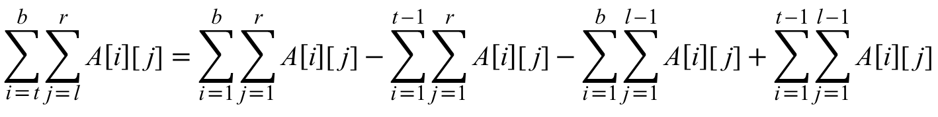
 |  |  |  | l | r
 |  | 1 | 2 | 3 | 4 | 5
 | 1 | 1 | 2 | −1 | −4 | −20
t | 2 | −8 | −3 | 4 | 2 | 1
 | 3 | 3 | 8 | 10 | 1 | 3
b | 4 | −4 | −1 | 1 | 7 | −6
 |  |  |  | l | r
 |  | 1 | 2 | 3 | 4 | 5
t−1 | 1 | 1 | 2 | −1 | −4 | −20
t | 2 | −8 | −3 | 4 | 2 | 1
 | 3 | 3 | 8 | 10 | 1 | 3
b | 4 | −4 | −1 | 1 | 7 | −6
 |  |  | l−1 | l | r
 |  | 1 | 2 | 3 | 4 | 5
 | 1 | 1 | 2 | −1 | −4 | −20
t | 2 | −8 | −3 | 4 | 2 | 1
 | 3 | 3 | 8 | 10 | 1 | 3
b | 4 | −4 | −1 | 1 | 7 | −6
 |  |  | l−1 | l | r
 |  | 1 | 2 | 3 | 4 | 5
t−1 | 1 | 1 | 2 | −1 | −4 | −20
t | 2 | −8 | −3 | 4 | 2 | 1
 | 3 | 3 | 8 | 10 | 1 | 3
b | 4 | −4 | −1 | 1 | 7 | −6
$$\sum_{\text{i}\text{=}\text{t}}^{\text{b}}{\sum_{\text{j}\text{=}\text{l}}^{\text{r}}{\text{A}\left[\text{i}\right]\text{[ }\text{j}\text{]}}}=\sum_{\text{i}\text{=}\text{1}}^{\text{b}}{\sum_{\text{j}\text{=}\text{1}}^{\text{r}}{\text{A}\left[\text{i}\right]\text{[ }\text{j}\text{]}}}−\sum_{\text{i}\text{=}\text{1}}^{\text{t}\text{−}\text{1}}{\sum_{\text{j}\text{=}\text{1}}^{\text{r}}{\text{A}\left[\text{i}\right]\text{[ }\text{j}\text{]}}}−\sum_{\text{i}\text{=}\text{1}}^{\text{b}}{\sum_{\text{j}\text{=}\text{1}}^{\text{l}\text{−}\text{1}}{\text{A}\left[\text{i}\right]\text{[ }\text{j}\text{]}}}+\sum_{\text{i}\text{=}\text{1}}^{\text{t}\text{−}\text{1}}{\sum_{\text{j}\text{=}\text{1}}^{\text{l}\text{−}\text{1}}{\text{A}\left[\text{i}\right]\text{[ }\text{j}\text{]}}}$$

Slide 6
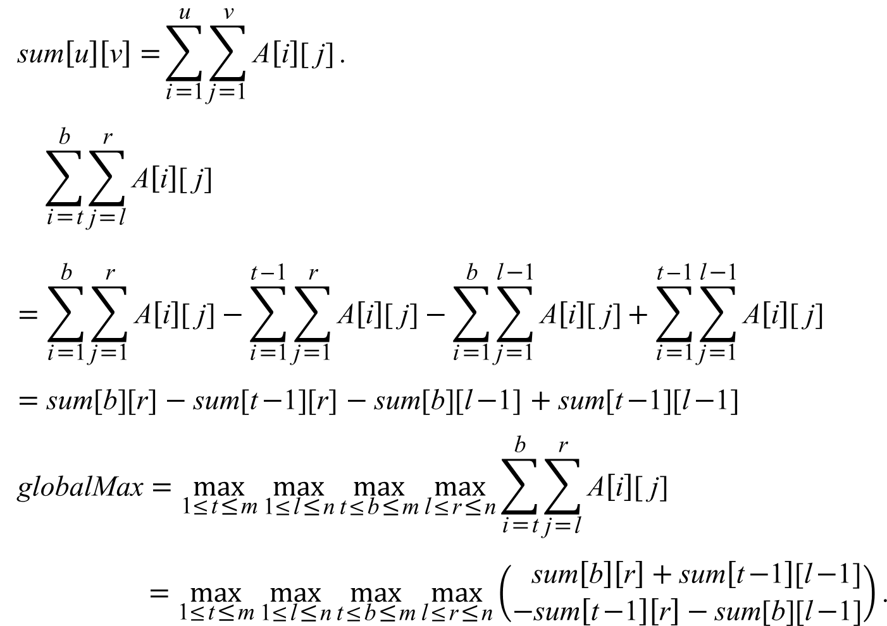
$$\text{sum}\left[\text{u}\right]\left[\text{v}\right] \text{=}\sum_{\text{i}\text{=}\text{1}}^{\text{u}}{\sum_{\text{j}\text{=}\text{1}}^{\text{v}}{\text{A}\left[\text{i}\right]\text{[ }\text{j}\text{]}}}\text{.}$$
$$\sum_{\text{i}\text{=}\text{t}}^{\text{b}}{\sum_{\text{j}\text{=}\text{l}}^{\text{r}}{\text{A}\left[\text{i}\right]\text{[ }\text{j}\text{]}}}$$
$$=\sum_{\text{i}\text{=}\text{1}}^{\text{b}}{\sum_{\text{j}\text{=}\text{1}}^{\text{r}}{\text{A}\left[\text{i}\right]\text{[ }\text{j}\text{]}}}−\sum_{\text{i}\text{=}\text{1}}^{\text{t}\text{−}\text{1}}{\sum_{\text{j}\text{=}\text{1}}^{\text{r}}{\text{A}\left[\text{i}\right]\text{[ }\text{j}\text{]}}}−\sum_{\text{i}\text{=}\text{1}}^{\text{b}}{\sum_{\text{j}\text{=}\text{1}}^{\text{l}\text{−}\text{1}}{\text{A}\left[\text{i}\right]\text{[ }\text{j}\text{]}}}+\sum_{\text{i}\text{=}\text{1}}^{\text{t}\text{−}\text{1}}{\sum_{\text{j}\text{=}\text{1}}^{\text{l}\text{−}\text{1}}{\text{A}\left[\text{i}\right]\text{[ }\text{j}\text{]}}}$$
= sum[b][r] − sum[t−1][r] − sum[b][l−1] + sum[t−1][l−1]
$$\text{globalMax}=\max_{\text{1}\text{≤}\text{t}\text{≤}\text{m}}{\max_{\text{1}\text{≤}\text{l}\text{≤}\text{n}}{\max_{\text{t}\text{≤}\text{b}\text{≤}\text{m}}{\max_{\text{l}\text{≤}\text{r}\text{≤}\text{n}}{\sum_{\text{i}\text{=}\text{t}}^{\text{b}}{\sum_{\text{j}\text{=}\text{l}}^{\text{r}}{\text{A}\left[\text{i}\right]\text{[ }\text{j}\text{]}}}}}}}$$
$$=\max_{\text{1}\text{≤}\text{t}\text{≤}\text{m}}{\max_{\text{1}\text{≤}\text{l}\text{≤}\text{n}}{\max_{\text{t}\text{≤}\text{b}\text{≤}\text{m}}{\max_{\text{l}\text{≤}\text{r}\text{≤}\text{n}}\left(\begin{aligned} \text{sum}\left[\text{b}\right]\left[\text{r}\right]+\text{sum}\left[\text{t}\text{−}\text{1}\right]\text{[}\text{l}\text{−}\text{1]} \\ −\text{sum}\left[\text{t}\text{−}\text{1}\right]\left[\text{r}\right]−\text{sum}\text{[}\text{b}\text{][}\text{l}\text{−}\text{1]}\end{aligned}\right)}}}\text{.}$$
 |  |  |  | l | r
 |  | 1 | 2 | 3 | 4 | 5
 | 1 | 1 | 2 | −1 | −4 | −20
t | 2 | −8 | −3 | 4 | 2 | 1
 | 3 | 3 | 8 | 10 | 1 | 3
b | 4 | −4 | −1 | 1 | 7 | −6

Slide 7
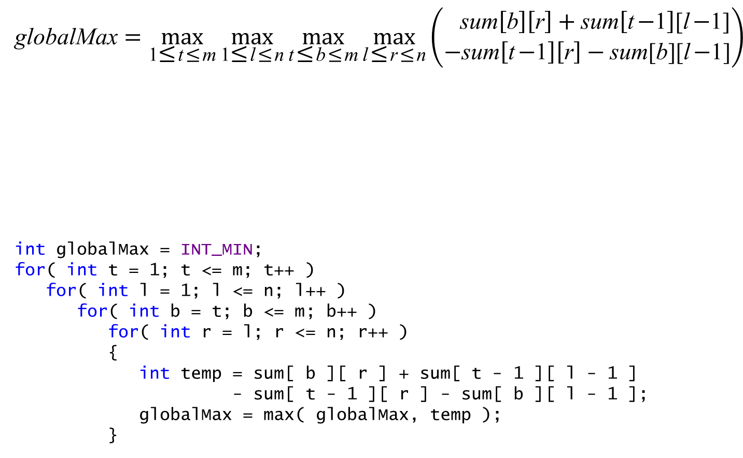
$$\text{globalMax}=\max_{\text{1}\text{≤}\text{t}\text{≤}\text{m}}{\max_{\text{1}\text{≤}\text{l}\text{≤}\text{n}}{\max_{\text{t}\text{≤}\text{b}\text{≤}\text{m}}{\max_{\text{l}\text{≤}\text{r}\text{≤}\text{n}}\left(\begin{aligned} \text{sum}\left[\text{b}\right]\left[\text{r}\right]+\text{sum}\left[\text{t}\text{−}\text{1}\right]\text{[}\text{l}\text{−}\text{1]} \\ −\text{sum}\left[\text{t}\text{−}\text{1}\right]\left[\text{r}\right]−\text{sum}\text{[}\text{b}\text{][}\text{l}\text{−}\text{1]}\end{aligned}\right)}}}$$
sum[ m + 1 ][ n + 1 ] = {};
for( int i = 1; i <= m; i++ )
for( int j = 1; j <= n; j++ )
sum[ i ][ j ] = A[ i ][ j ] - sum[ i - 1 ][ j - 1 ]
+ sum[ i - 1 ][ j ] + sum[ i ][ j - 1 ];
int globalMax = INT_MIN;
for( int t = 1; t <= m; t++ )
for( int l = 1; l <= n; l++ )
for( int b = t; b <= m; b++ )
for( int r = l; r <= n; r++ )
{
int temp = sum[ b ][ r ] + sum[ t - 1 ][ l - 1 ]
- sum[ t - 1 ][ r ] - sum[ b ][ l - 1 ];
globalMax = max( globalMax, temp );
}

Slide 8
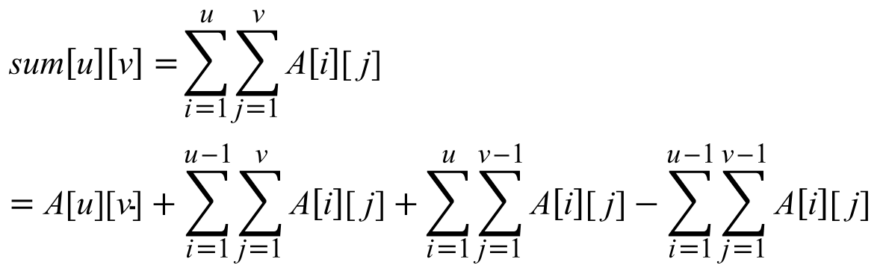
 | 1 | 2 | 3 | 4 | 5
1 | 1 | 2 | −1 | −4 | −20
2 | −8 | −3 | 4 | 2 | 1
3 | 3 | 8 | 10 | 1 | 3
4 | −4 | −1 | 1 | 7 | −6
 | 1 | 2 | 3 | 4 | 5
1 | 1 | 2 | −1 | −4 | −20
2 | −8 | −3 | 4 | 2 | 1
3 | 3 | 8 | 10 | 1 | 3
4 | −4 | −1 | 1 | 7 | −6
 | 1 | 2 | 3 | 4 | 5
1 | 1 | 2 | −1 | −4 | −20
2 | −8 | −3 | 4 | 2 | 1
3 | 3 | 8 | 10 | 1 | 3
4 | −4 | −1 | 1 | 7 | −6
 | 1 | 2 | 3 | 4 | 5
1 | 1 | 2 | −1 | −4 | −20
2 | −8 | −3 | 4 | 2 | 1
3 | 3 | 8 | 10 | 1 | 3
4 | −4 | −1 | 1 | 7 | −6
$$\text{sum}\left[\text{u}\right]\left[\text{v}\right] \text{=}\sum_{\text{i}\text{=}\text{1}}^{\text{u}}{\sum_{\text{j}\text{=}\text{1}}^{\text{v}}{\text{A}\left[\text{i}\right]\text{[ }\text{j}\text{]}}}$$
$$=\text{A}\text{[}\text{u}\text{][}\text{v}\text{]}+\sum_{\text{i}\text{=}\text{1}}^{\text{u}\text{−}\text{1}}{\sum_{\text{j}\text{=}\text{1}}^{\text{v}}{\text{A}\left[\text{i}\right]\text{[ }\text{j}\text{]}}}+\sum_{\text{i}\text{=}\text{1}}^{\text{u}}{\sum_{\text{j}\text{=}\text{1}}^{\text{v}\text{−}\text{1}}{\text{A}\left[\text{i}\right]\text{[ }\text{j}\text{]}}}−\sum_{\text{i}\text{=}\text{1}}^{\text{u}\text{−}\text{1}}{\sum_{\text{j}\text{=}\text{1}}^{\text{v}\text{−}\text{1}}{\text{A}\left[\text{i}\right]\text{[ }\text{j}\text{]}}}$$

Slide 9
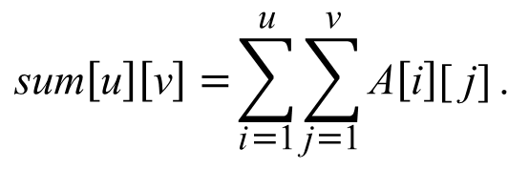
 | 1 | 2 | 3 | 4 | 5
1 | 1 | 2 | −1 | −4 | −20
2 | −8 | −3 | 4 | 2 | 1
3 | 3 | 8 | 10 | 1 | 3
4 | −4 | −1 | 1 | 7 | −6
 | 1 | 2 | 3 | 4 | 5
1 | 1 | 2 | −1 | −4 | −20
2 | −8 | −3 | 4 | 2 | 1
3 | 3 | 8 | 10 | 1 | 3
4 | −4 | −1 | 1 | 7 | −6
 | 1 | 2 | 3 | 4 | 5
1 | 1 | 2 | −1 | −4 | −20
2 | −8 | −3 | 4 | 2 | 1
3 | 3 | 8 | 10 | 1 | 3
4 | −4 | −1 | 1 | 7 | −6
 | 1 | 2 | 3 | 4 | 5
1 | 1 | 2 | −1 | −4 | −20
2 | −8 | −3 | 4 | 2 | 1
3 | 3 | 8 | 10 | 1 | 3
4 | −4 | −1 | 1 | 7 | −6
$$\text{sum}\left[\text{u}\right]\left[\text{v}\right] \text{=}\sum_{\text{i}\text{=}\text{1}}^{\text{u}}{\sum_{\text{j}\text{=}\text{1}}^{\text{v}}{\text{A}\left[\text{i}\right]\text{[ }\text{j}\text{]}}}\text{.}$$
sum[0][v] = 0 for v = 0, 1, . . , n.
sum[u][0] = 0 for u = 0, 1, . . , m.
sum[u][v] = A[u][v] + sum[u−1][v] + sum[u][v−1] − sum[u−1][v−1]
for u = 1, 2, . . , m, v = 1, 2, . . , n.

Slide 10
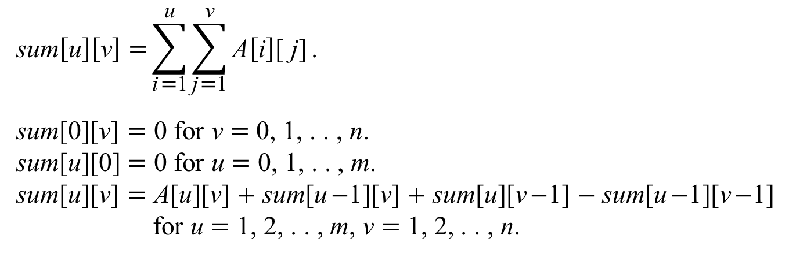
 | 1 | 2 | 3 | 4 | 5
1 | 1 | 2 | −1 | −4 | −20
2 | −8 | −3 | 4 | 2 | 1
3 | 3 | 8 | 10 | 1 | 3
4 | −4 | −1 | 1 | 7 | −6
 | 0 | 1 | 2 | 3 | 4 | 5
0 | 0 | 0 | 0 | 0 | 0 | 0
1 | 0 | 1 | 2 | −1 | −4 | −20
2 | 0 | −8 | −3 | 4 | 2 | 1
3 | 0 | 3 | 8 | 10 | 1 | 3
4 | 0 | −4 | −1 | 1 | 7 | −6
A
$$\text{sum}\left[\text{u}\right]\left[\text{v}\right] \text{=}\sum_{\text{i}\text{=}\text{1}}^{\text{u}}{\sum_{\text{j}\text{=}\text{1}}^{\text{v}}{\text{A}\left[\text{i}\right]\text{[ }\text{j}\text{]}}}\text{.}$$
sum[0][v] = 0 for v = 0, 1, . . , n.
sum[u][0] = 0 for u = 0, 1, . . , m.
sum[u][v] = A[u][v] + sum[u−1][v] + sum[u][v−1] − sum[u−1][v−1]
for u = 1, 2, . . , m, v = 1, 2, . . , n.
A
int sum[ m + 1 ][ n + 1 ] = {};
for( int i = 1; i <= m; i++ )
for( int j = 1; j <= n; j++ )
sum[ i ][ j ] = A[ i ][ j ] - sum[ i - 1 ][ j - 1 ]
+ sum[ i - 1 ][ j ] + sum[ i ][ j - 1 ];

Slide 11
 | 1 | 2 | 3 | 4 | 5
1 | 1 | 2 | −1 | −4 | −20
2 | −8 | −3 | 4 | 2 | 1
3 | 3 | 8 | 10 | 1 | 3
4 | −4 | −1 | 1 | 7 | −6
 | 0 | 1 | 2 | 3 | 4 | 5
0 | 0 | 0 | 0 | 0 | 0 | 0
1 | 0 | 1 | 3 | 2 | −2 | −22
2 | 0 | −7 | −8 | −5 | −7 | −26
3 | 0 | −4 | 3 | 16 | 15 | −1
4 | 0 | −8 | −2 | 12 | 18 | −4
A
$$\text{sum}\left[\text{u}\right]\left[\text{v}\right] \text{=}\sum_{\text{i}\text{=}\text{1}}^{\text{u}}{\sum_{\text{j}\text{=}\text{1}}^{\text{v}}{\text{A}\left[\text{i}\right]\text{[ }\text{j}\text{]}}}\text{.}$$
sum[0][v] = 0 for v = 0, 1, . . , n.
sum[u][0] = 0 for u = 0, 1, . . , m.
sum[u][v] = A[u][v] + sum[u−1][v] + sum[u][v−1] − sum[u−1][v−1]
for u = 1, 2, . . , m, v = 1, 2, . . , n.
sum
int sum[ m + 1 ][ n + 1 ] = {};
for( int i = 1; i <= m; i++ )
for( int j = 1; j <= n; j++ )
sum[ i ][ j ] = A[ i ][ j ] - sum[ i - 1 ][ j - 1 ]
+ sum[ i - 1 ][ j ] + sum[ i ][ j - 1 ];

Slide 12
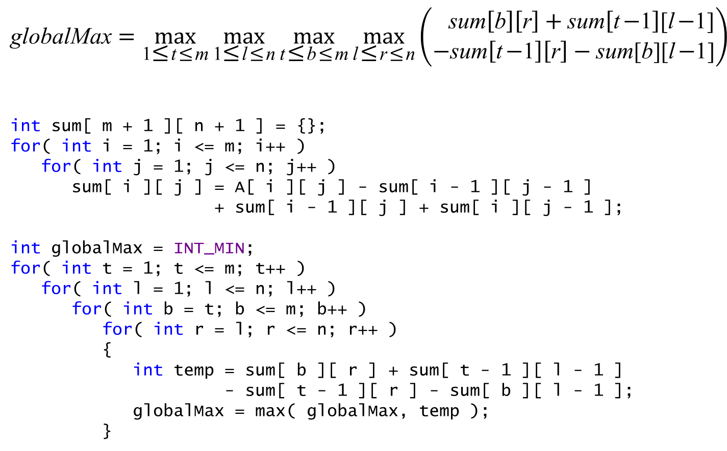
$$\text{globalMax}=\max_{\text{1}\text{≤}\text{t}\text{≤}\text{m}}{\max_{\text{1}\text{≤}\text{l}\text{≤}\text{n}}{\max_{\text{t}\text{≤}\text{b}\text{≤}\text{m}}{\max_{\text{l}\text{≤}\text{r}\text{≤}\text{n}}\left(\begin{aligned} \text{sum}\left[\text{b}\right]\left[\text{r}\right]+\text{sum}\left[\text{t}\text{−}\text{1}\right]\text{[}\text{l}\text{−}\text{1]} \\ −\text{sum}\left[\text{t}\text{−}\text{1}\right]\left[\text{r}\right]−\text{sum}\text{[}\text{b}\text{][}\text{l}\text{−}\text{1]}\end{aligned}\right)}}}$$
int sum[ m + 1 ][ n + 1 ] = {};
for( int i = 1; i <= m; i++ )
for( int j = 1; j <= n; j++ )
sum[ i ][ j ] = A[ i ][ j ] - sum[ i - 1 ][ j - 1 ]
+ sum[ i - 1 ][ j ] + sum[ i ][ j - 1 ];
int globalMax = INT_MIN;
for( int t = 1; t <= m; t++ )
for( int l = 1; l <= n; l++ )
for( int b = t; b <= m; b++ )
for( int r = l; r <= n; r++ )
{
int temp = sum[ b ][ r ] + sum[ t - 1 ][ l - 1 ]
- sum[ t - 1 ][ r ] - sum[ b ][ l - 1 ];
globalMax = max( globalMax, temp );
}

Slide 13
 | 1 | 2 | 3 | 4 | 5
1 | 1 | 2 | −1 | −4 | −20
2 | −8 | −3 | 4 | 2 | 1
3 | 3 | 8 | 10 | 1 | 3
4 | −4 | −1 | 1 | 7 | −6
 | 1 | 2 | 3 | 4 | 5
1 | 1 | 2 | −1 | −4 | −20
2 | −8 | −3 | 4 | 2 | 1
3 | 3 | 8 | 10 | 1 | 3
4 | −4 | −1 | 1 | 7 | −6
sum
2
−7
21
−4
sum
1
−8
3
−4
 | 1 | 2 | 3 | 4 | 5
1 | 1 | 2 | −1 | −4 | −20
2 | −8 | −3 | 4 | 2 | 1
3 | 3 | 8 | 10 | 1 | 3
4 | −4 | −1 | 1 | 7 | −6
 | 1 | 2 | 3 | 4 | 5
1 | 1 | 2 | −1 | −4 | −20
2 | −8 | −3 | 4 | 2 | 1
3 | 3 | 8 | 10 | 1 | 3
4 | −4 | −1 | 1 | 7 | −6
sum
−2
−5
22
3
sum
3
−11
11
−5
 | 1 | 2 | 3 | 4 | 5
1 | 1 | 2 | −1 | −4 | −20
2 | −8 | −3 | 4 | 2 | 1
3 | 3 | 8 | 10 | 1 | 3
4 | −4 | −1 | 1 | 7 | −6
 | 1 | 2 | 3 | 4 | 5
1 | 1 | 2 | −1 | −4 | −20
2 | −8 | −3 | 4 | 2 | 1
3 | 3 | 8 | 10 | 1 | 3
4 | −4 | −1 | 1 | 7 | −6
sum
−22
−4
25
−3

Slide 14
sum
2
−3
8
−1
 | 1 | 2 | 3 | 4 | 5
1 | 1 | 2 | −1 | −4 | −20
2 | −8 | −3 | 4 | 2 | 1
3 | 3 | 8 | 10 | 1 | 3
4 | −4 | −1 | 1 | 7 | −6
 | 1 | 2 | 3 | 4 | 5
1 | 1 | 2 | −1 | −4 | −20
2 | −8 | −3 | 4 | 2 | 1
3 | 3 | 8 | 10 | 1 | 3
4 | −4 | −1 | 1 | 7 | −6
sum
−23
4
22
1
sum
1
1
18
0
 | 1 | 2 | 3 | 4 | 5
1 | 1 | 2 | −1 | −4 | −20
2 | −8 | −3 | 4 | 2 | 1
3 | 3 | 8 | 10 | 1 | 3
4 | −4 | −1 | 1 | 7 | −6
sum
−3
3
19
7
 | 1 | 2 | 3 | 4 | 5
1 | 1 | 2 | −1 | −4 | −20
2 | −8 | −3 | 4 | 2 | 1
3 | 3 | 8 | 10 | 1 | 3
4 | −4 | −1 | 1 | 7 | −6
 | 1 | 2 | 3 | 4 | 5
1 | 1 | 2 | −1 | −4 | −20
2 | −8 | −3 | 4 | 2 | 1
3 | 3 | 8 | 10 | 1 | 3
4 | −4 | −1 | 1 | 7 | −6

Slide 15
sum
−1
4
10
1
 | 1 | 2 | 3 | 4 | 5
1 | 1 | 2 | −1 | −4 | −20
2 | −8 | −3 | 4 | 2 | 1
3 | 3 | 8 | 10 | 1 | 3
4 | −4 | −1 | 1 | 7 | −6
 | 1 | 2 | 3 | 4 | 5
1 | 1 | 2 | −1 | −4 | −20
2 | −8 | −3 | 4 | 2 | 1
3 | 3 | 8 | 10 | 1 | 3
4 | −4 | −1 | 1 | 7 | −6
sum
−4
2
1
7
sum
−5
6
11
8
 | 1 | 2 | 3 | 4 | 5
1 | 1 | 2 | −1 | −4 | −20
2 | −8 | −3 | 4 | 2 | 1
3 | 3 | 8 | 10 | 1 | 3
4 | −4 | −1 | 1 | 7 | −6
 | 1 | 2 | 3 | 4 | 5
1 | 1 | 2 | −1 | −4 | −20
2 | −8 | −3 | 4 | 2 | 1
3 | 3 | 8 | 10 | 1 | 3
4 | −4 | −1 | 1 | 7 | −6
sum
−24
3
4
1
sum
−25
7
14
2
 | 1 | 2 | 3 | 4 | 5
1 | 1 | 2 | −1 | −4 | −20
2 | −8 | −3 | 4 | 2 | 1
3 | 3 | 8 | 10 | 1 | 3
4 | −4 | −1 | 1 | 7 | −6
 | 1 | 2 | 3 | 4 | 5
1 | 1 | 2 | −1 | −4 | −20
2 | −8 | −3 | 4 | 2 | 1
3 | 3 | 8 | 10 | 1 | 3
4 | −4 | −1 | 1 | 7 | −6
sum
−20
1
3
−6

Slide 16
void max2DRangeSum( int A[][ n + 1 ] )
{
for( int l = 1; l <= n; ++l )
{
memset( rowSum, 0, sizeof( rowSum ) );
for( int r = l; r <= n; ++r )
{
for( int i = 1; i <= m; ++i )
rowSum[ i ] += A[ i ][ r ];
localMax = max1DRangeSum( rowSum );
if( globalMax < localMax )
globalMax = localMax;
}
}
}

Slide 17
sum
2
−3
8
−1
 | 1 | 2 | 3 | 4 | 5
1 | 1 | 2 | −1 | −4 | −20
2 | −8 | −3 | 4 | 2 | 1
3 | 3 | 8 | 10 | 1 | 3
4 | −4 | −1 | 1 | 7 | −6
 | 1 | 2 | 3 | 4 | 5
1 | 1 | 2 | −1 | −4 | −20
2 | −8 | −3 | 4 | 2 | 1
3 | 3 | 8 | 10 | 1 | 3
4 | −4 | −1 | 1 | 7 | −6
sum
−3
3
19
7
sum
1
1
18
0
 | 1 | 2 | 3 | 4 | 5
1 | 1 | 2 | −1 | −4 | −20
2 | −8 | −3 | 4 | 2 | 1
3 | 3 | 8 | 10 | 1 | 3
4 | −4 | −1 | 1 | 7 | −6
 | 1 | 2 | 3 | 4 | 5
1 | 1 | 2 | −1 | −4 | −20
2 | −8 | −3 | 4 | 2 | 1
3 | 3 | 8 | 10 | 1 | 3
4 | −4 | −1 | 1 | 7 | −6
sum
−23
4
22
1
for( int r = l; r <= n; ++r )
{
for( int i = 1; i <= m; ++i )
rowSum[ i ] += A[ i ][ r ];
localMax = max1DRangeSum( rowSum );
if( globalMax < localMax )
globalMax = localMax;
}

Slide 18
int max1DRangeSum( int column[] )
{
int globalMax = column[ 1 ];
int localMax = column[ 1 ];
for( int i = 2; i <= m; i++ )
{
localMax = max( column[ i ], localMax + column[ i ] );
if( globalMax < localMax )
globalMax = localMax;
}
return globalMax;
}

Slide 19
void max2DRangeSum( int A[][ n + 1 ] )
{
for( int l = 1; l <= n; ++l )
{
memset( rowSum, 0, sizeof( rowSum ) );
for( int r = l; r <= n; ++r )
{
for( int i = 1; i <= m; ++i )
rowSum[ i ] += A[ i ][ r ];
localMax = max1DRangeSum( rowSum );
if( globalMax < localMax )
globalMax = localMax;
}
}
}
int max1DRangeSum( int column[] )
{
int globalMax = column[ 1 ];
int localMax = column[ 1 ];
for( int i = 2; i <= m; i++ )
{
localMax = max( column[ i ], localMax + column[ i ] );
if( globalMax < localMax )
globalMax = localMax;
}
return globalMax;
}

Slide 20
void max2DRangeSum( int A[][ n + 1 ] )
{
int left, right, top, bottom;
int globalMax, localMax;
for( int l = 1; l <= n; ++l )
{
memset( rowSum, 0, sizeof( rowSum ) );
for( int r = l; r <= n; ++r )
{
for( int i = 1; i <= m; ++i )
rowSum[ i ] += A[ i ][ r ];
int begin, end;
localMax = max1DRangeSum( rowSum, begin, end );
if( globalMax < localMax )
{
globalMax = localMax;
left = l;
right = r;
top = begin;
bottom = end;
}
}
}
}

Slide 21
int max1DRangeSum( int A[], int &begin, int &end )
{
begin = 1;
end = 1;
int newBegin = 1;
int localMax = A[ 1 ];
int globalMax = A[ 1 ];
for( int newEnd = 2; newEnd <= n; newEnd++ )
{
localMax = max( A[ newEnd ], localMax + A[ newEnd ] );
if( globalMax < localMax )
globalMax = localMax;
if( localMax < 0 )
newBegin = newEnd + 1;
else if( localMax == globalMax )
{
begin = newBegin;
end = newEnd;
}
}
return globalMax;
}

